Slide 1
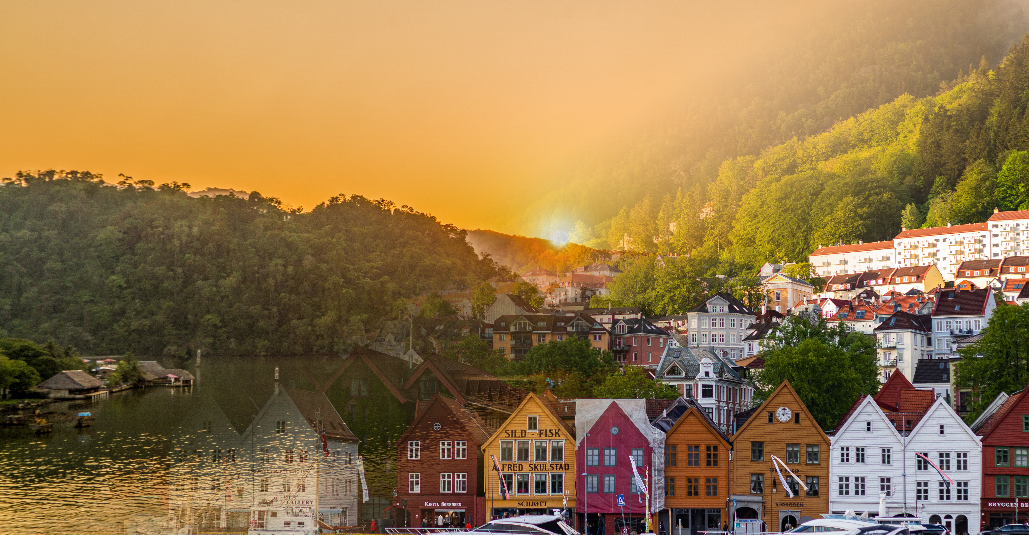
Norway
Guatemala
A comparison between developed and developing countries around the world
Created By: Max & Ryan

Slide 2
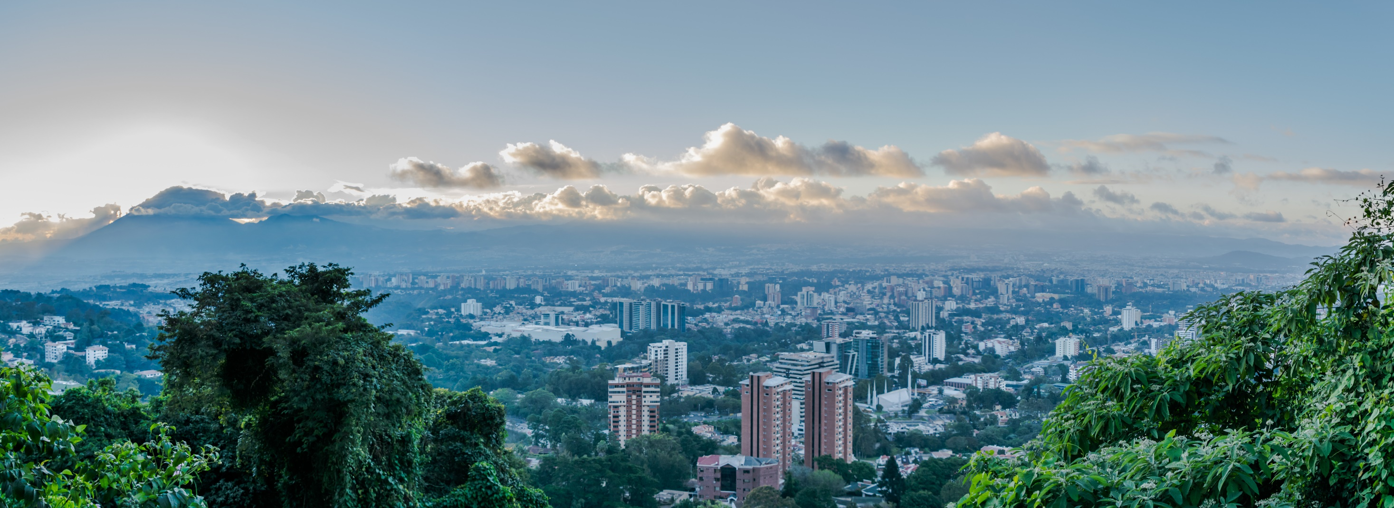

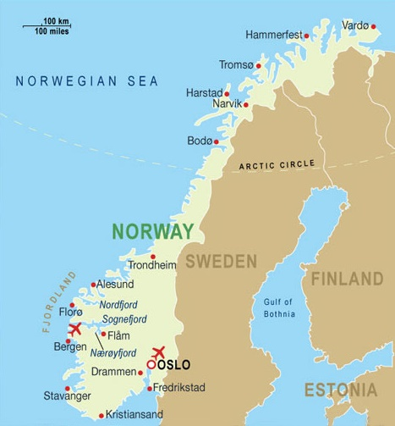
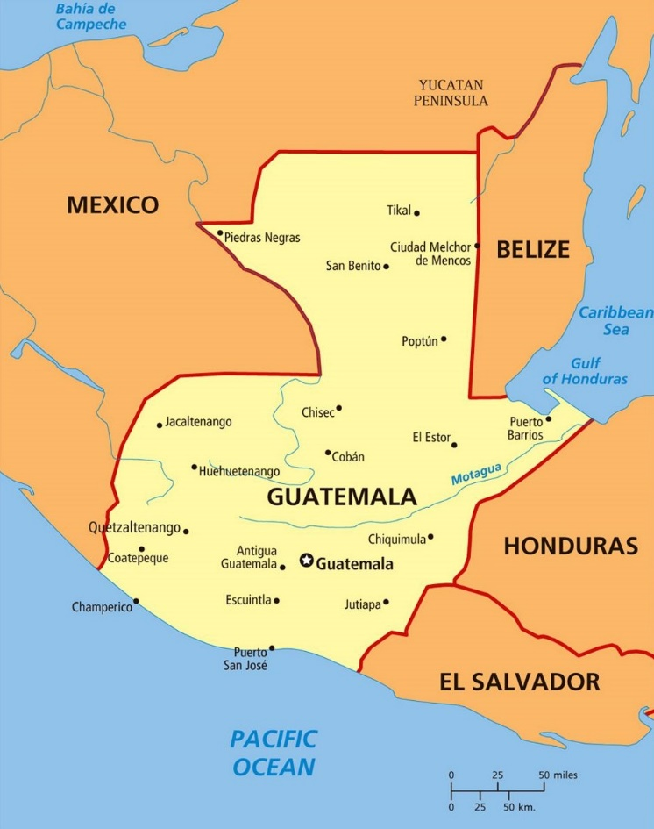
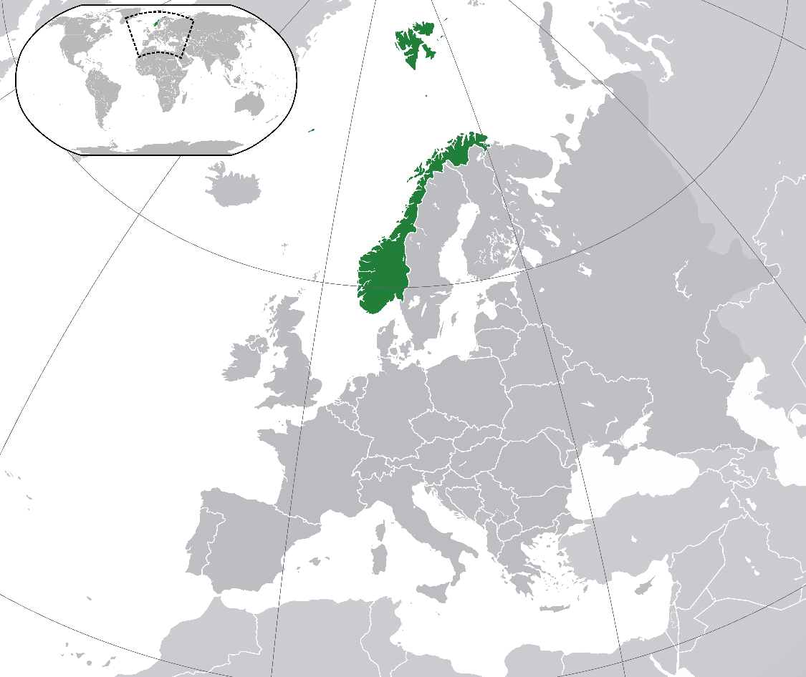

Norway
Location
Norway is in the upper part of the northern hemisphere with part of its land above the Arctic Circle.
Oslo is located on the southern end of the country with a population of 672,061.

Slide 3
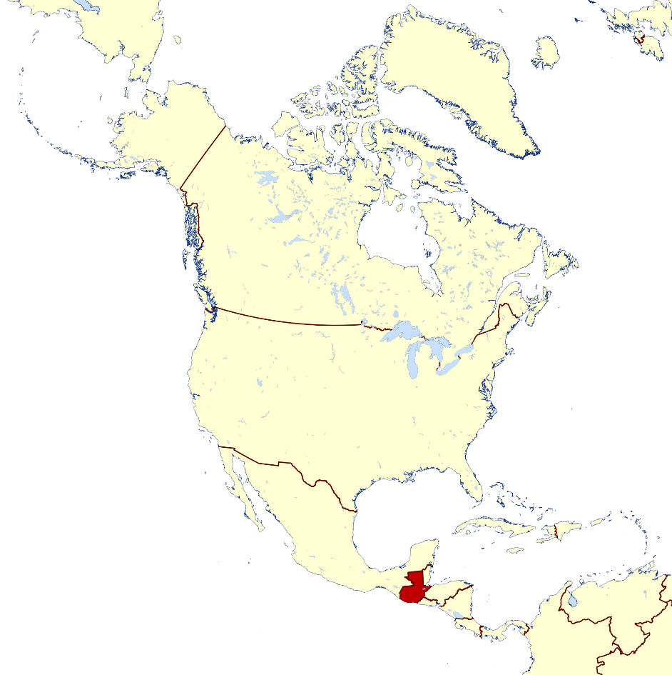
Guatemala
Location
Guatemala borders Mexico, El Salvador, Honduras, and Belize near the southern tip of North America.
Guatemala City is found in the Guatemala Highlands and is the largest city in Central America with a population of around 1 million.

Slide 4
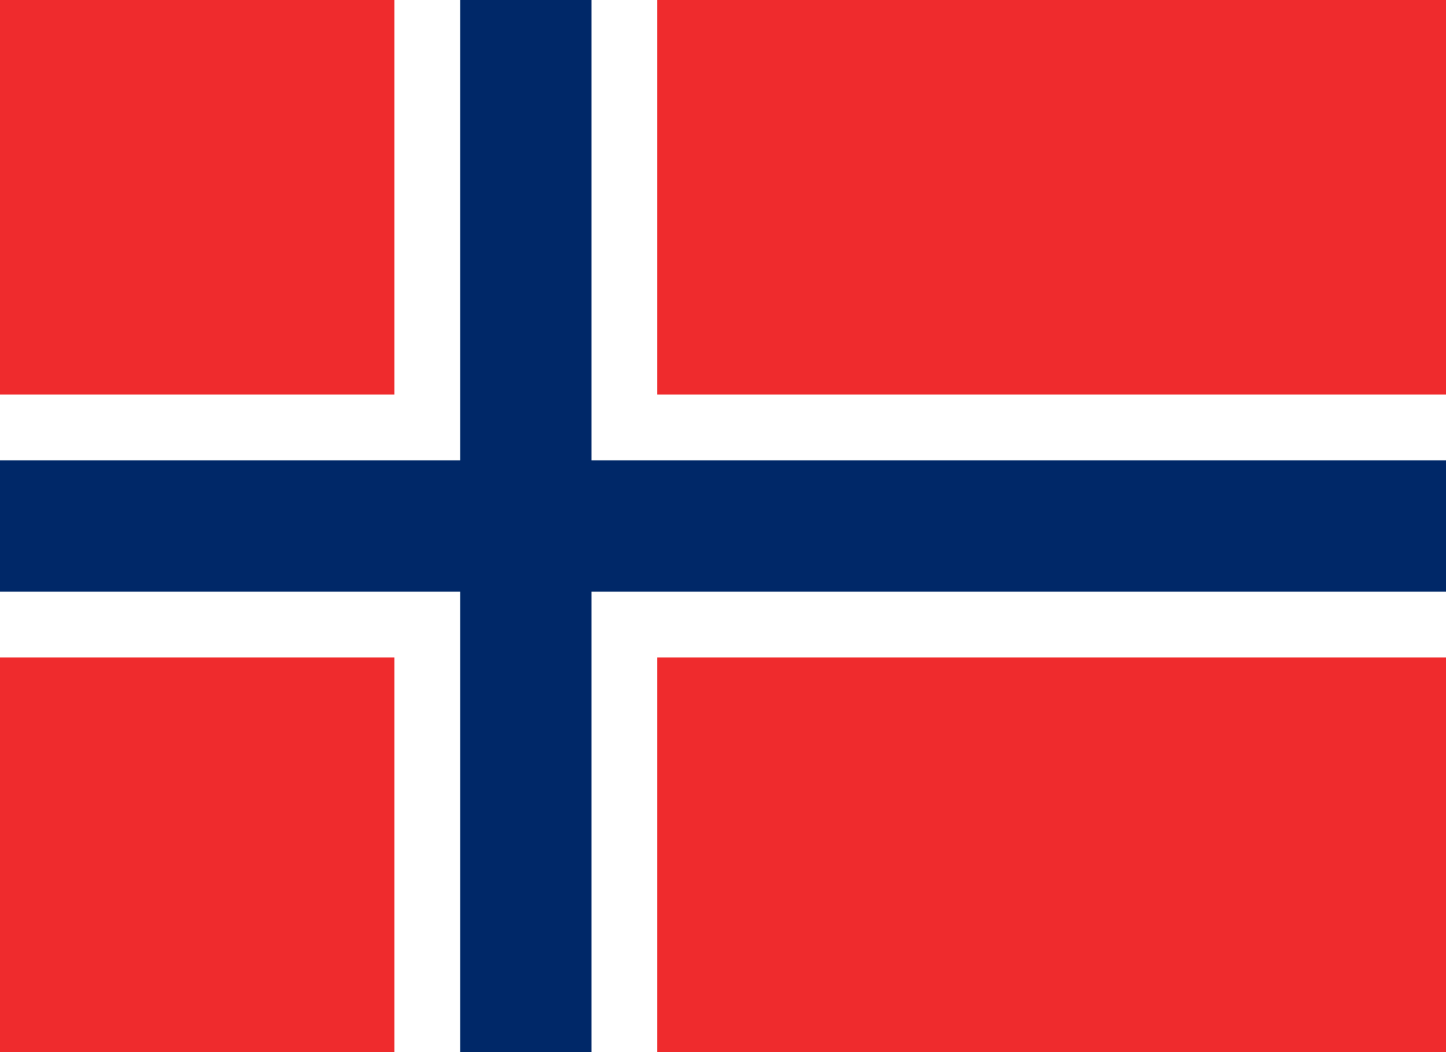
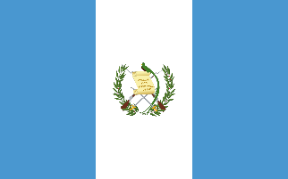
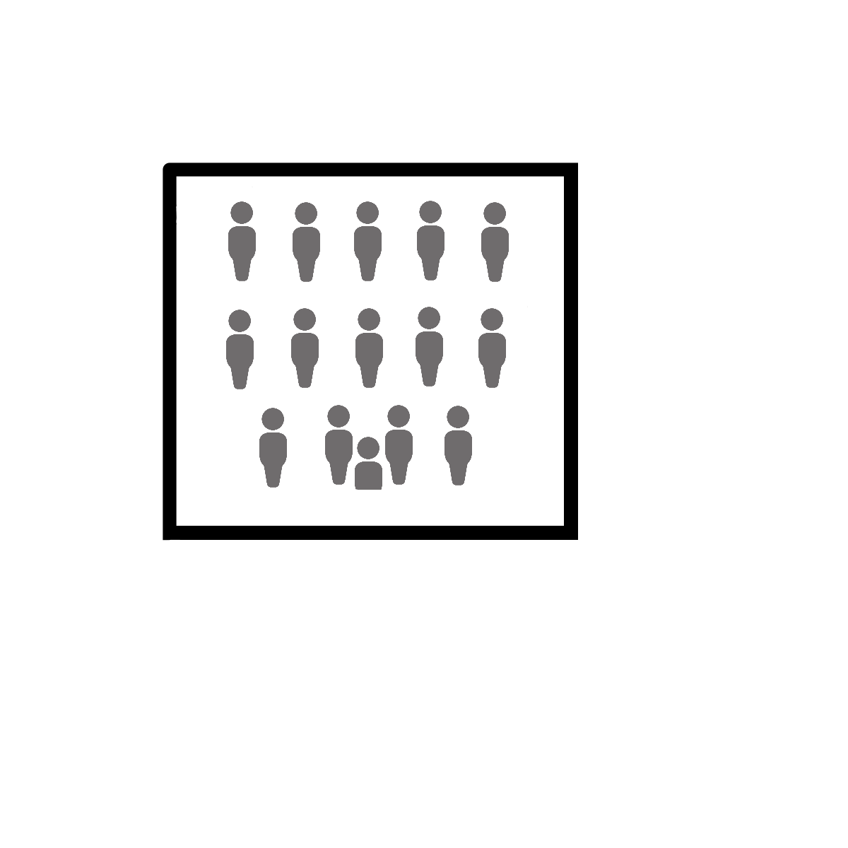
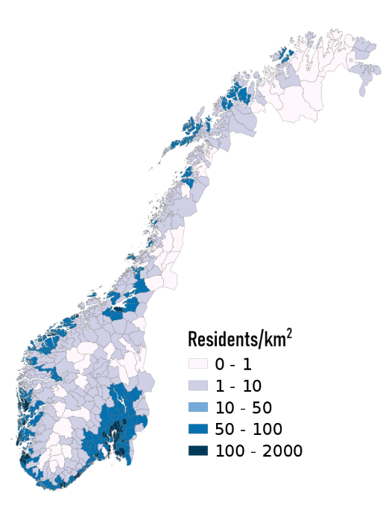
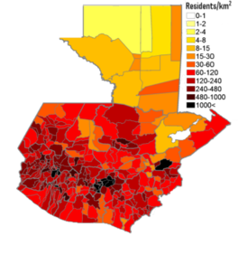

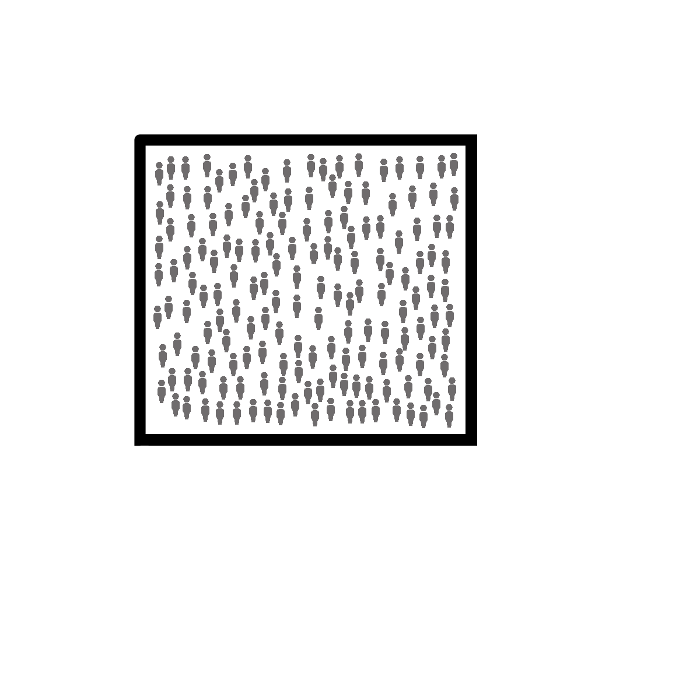



Demographics
Guatemala’s population
density per administrative
boundaries^{(2014)[4]}
Norway’s population density
per municipality^{(2016)[3]}
Norway- 14.5 people/km²
323,802 km^{2[1]}
108,889 km²
Guatemala- 157.8 people/km^{2[2]}
5,372,191
16,581,273^{[5]}
+0.94%/yr.
+1.72%/yr.
5.3 migrants/1000
-2.4 migrants/1000^{[5]}
Notes:
https://data.worldbank.org/indicator/EN.POP.DNST?locations=NO
https://data.worldbank.org/indicator/EN.POP.DNST?locations=GT
https://en.wikipedia.org/wiki/Demographics_of_Norway
https://popdensitymap.ucoz.ru/news/32_population_density_administrative_boundaries_map_of_guatemala/2014-02-04-35
https://data.worldbank.org/country/guatemala

Slide 5
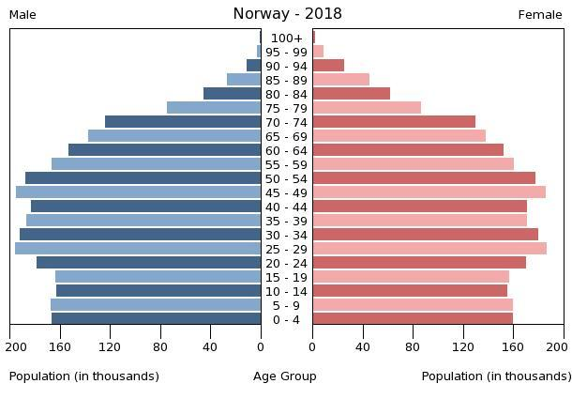
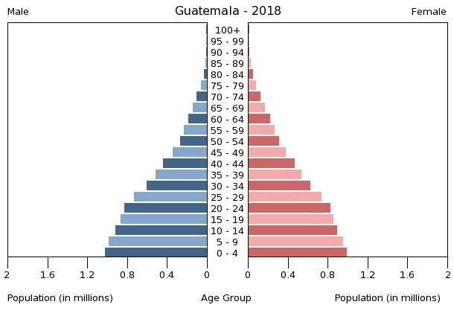
Demographics – Cont.
Demographics
Norway’s Population Pyramid- Stable
Guatemala’s Population Pyramid- Expanding

Slide 6
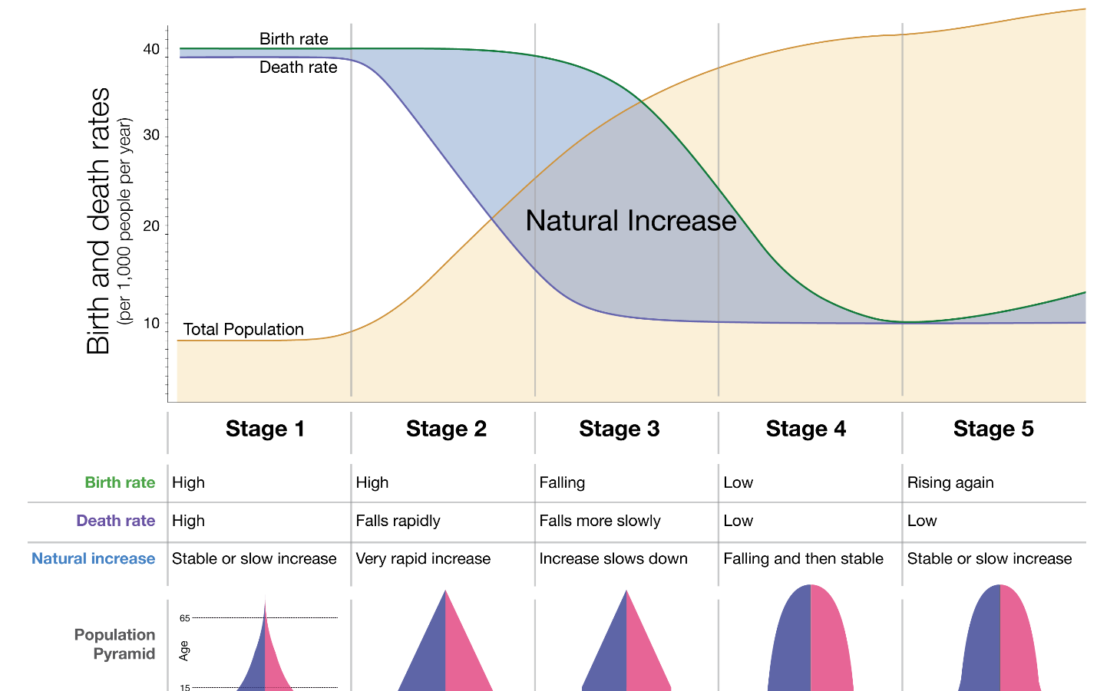
Demographics – Cont.
Demographics
Guatemala²
Norway¹
Demographic Transition Model
https://www.npr.org/templates/story/story.php?storyId=106439600
https://www.researchgate.net/profile/Andres_Fernandez9/publication/242572471/figure/fig1/AS:669422511476746@1536614172303/DEMOGRAPHIC-GROWTH-RATE-IN-LATIN-AMERICAN-COUNTRIES-BY-STAGE-OF-DEMOGRAPHIC-TRANSITION.png

Slide 7

Demographics – Cont.
Literacy Rate
Literacy Rate
99% ages 15+, education is only mandatory from ages 6-15.
81.5% ages 15+
77% female, 87% male.
Median Age
Median Age
39.3 years;
40 yrs. female, 38.6 yrs. male.
22.5 years;
23.1 yrs. female, 22 yrs. male.
Birth/Death/Infant Mortality Rate
Birth/Death/Infant Mortality Rate
12.2 births/1000 people
8 deaths/1000 people
2.6/1000 births (0.26%)
24.6 births/1000 people
5 deaths/1000 people
23.9/1000 births (2.39%)
Human Development Index
Human Development Index
0.953; 1st/189
0.650; 127th/189

Slide 8



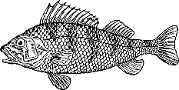
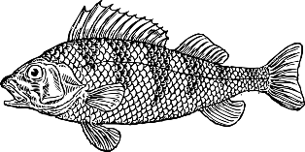

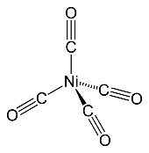


Natural Resources
Hydropower
Bubble Gum (Chicle)
Exporting hydropower to European countries
Large reserves of chicle, a main ingredient in bubble gum gets exported to manufactures in the US
Timber
Fish
A quarter of Norway is covered in forests, making it valuable for forestry industries
Best place in the world to fish for pacific sailfish
Fish
Rare Woods
Largest Atlantic Salmon producer in the world
Many rare wood species exist in its diverse forests (Mahogany, Pucte, etc.)
Metals
Nickel
Mines and exports iron, copper, lead, zinc, titanium and pyrites.
The Fenix Mine is the largest nickel mine in Central America and is Canadian owned
Petroleum & Natural Gas
Petroleum
Accounts for 49% of exports in 2017
Guatemala is the only country in Central America that produces oil

Slide 9
Trade
Norway’s Trade Balance
Guatemala’s Trade Balance

Slide 10
Trade- GDP
Trade

Slide 11
Trade- GDP per capita
Trade
Trade- GDP

Slide 12
Trade
Trade- Industries
PPT模板下载：www.1ppt.com/moban/ 行业PPT模板：www.1ppt.com/hangye/
节日PPT模板：www.1ppt.com/jieri/ PPT素材下载：www.1ppt.com/sucai/
PPT背景图片：www.1ppt.com/beijing/ PPT图表下载：www.1ppt.com/tubiao/
优秀PPT下载：www.1ppt.com/xiazai/ PPT教程： www.1ppt.com/powerpoint/
Word教程： www.1ppt.com/word/ Excel教程：www.1ppt.com/excel/
资料下载：www.1ppt.com/ziliao/ PPT课件下载：www.1ppt.com/kejian/
范文下载：www.1ppt.com/fanwen/ 试卷下载：www.1ppt.com/shiti/
教案下载：www.1ppt.com/jiaoan/ PPT论坛：www.1ppt.cn

Slide 13

Culture
Languages
Languages
Norwegian, Nynorsk, Bokmal, Saami
Spanish + 21 indigenous languages
Ethnic Groups
Ethnic Groups
83% Norwegian, 8% European, 9% Other
60.1% European & Mestizo, 39.3% Maya, 0.6% Other
Religion
Religion
Lutheran Christianity
Roman Catholic, Protestant, Indigenous Maya
National Anthem
National Anthem
Ja, vi elsker dette landet
Guatemala Feliz!

Slide 14

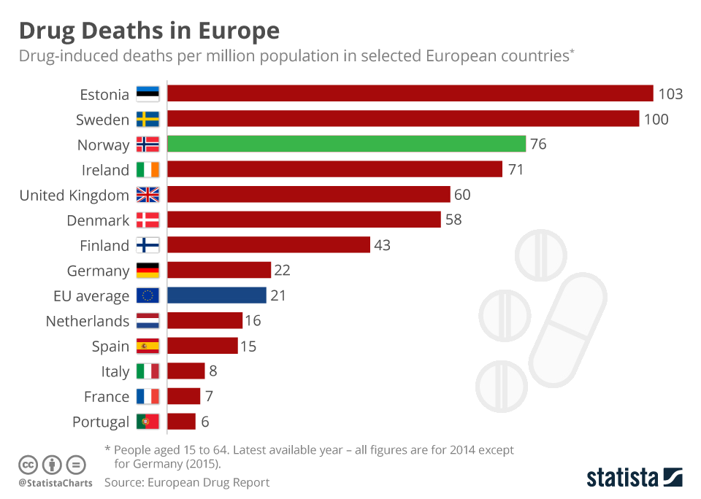
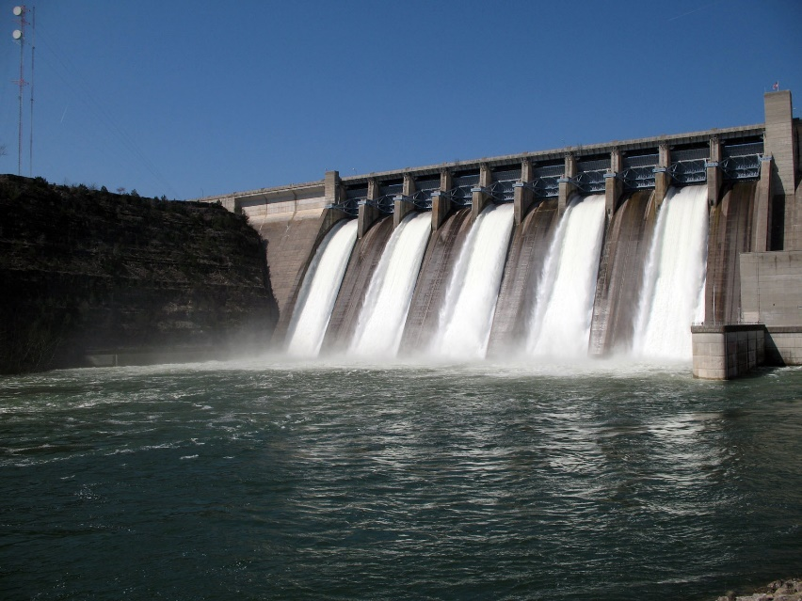
Diseases
Ischemic Heart Disease
Dengue Fever
Plaque build-up inside blood vessels; poor physical lifestyles increases risk
Mosquito transferred virus; recent outbreak in Guatemala
Alzheimer’s
Malaria
Researches at the University of Oslo have started testing patients with new cure
Risk only in low-laying rural areas
Cerebrovascular Disease
Typhoid Fever
Affects the blood supply to the brain; comparable to Ischemic Heart Disease
Risk in remote areas; vaccine available
Stroke
Hepatitis A
Steady decline of number of cases; unique compared to other Nordic countries
Poor sanitary infrastructure in Guatemala makes it easy to receive

Slide 15

Norway
Ecological- High use of hydro dams affects the surrounding environment
Gas & Oil Dependency- Half of Norway’s exports are gas & oil, and they need to adapt to an everchanging economy
Issues
Drug overdose graph in Europe
Hydroelectric dams are impeding of the entire ecological environment in the area, affecting wildlife, aquatic life and more
Drug Overdose- Have not met NATO targets in increasing defense and security in its country.
Acceptance in Rural Areas- Some rural places are still hostile towards anyone who is different (skin type, LGBTQIA+, etc.)

Slide 16

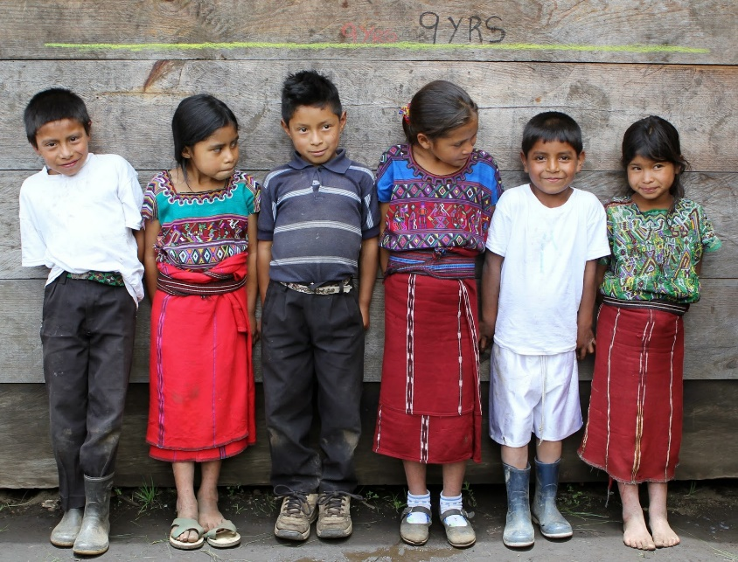
Norway
Ecological- Rebuilding river coastlines, creating new dams with a focus on the surrounding area
Gas & Oil Dependency- Shift towards more sectors that will continue to grow & limit drill areas
Solutions
Drug overdose graph in Europe
Hydroelectric dams are impeding of the entire ecological environment in the area, affecting wildlife, aquatic life and more
Drug Overdose- Currently testing free heroin prescriptions to improve quality of life for addicts
Acceptance in Rural Areas- Provide education about those people to help them understand

Slide 17
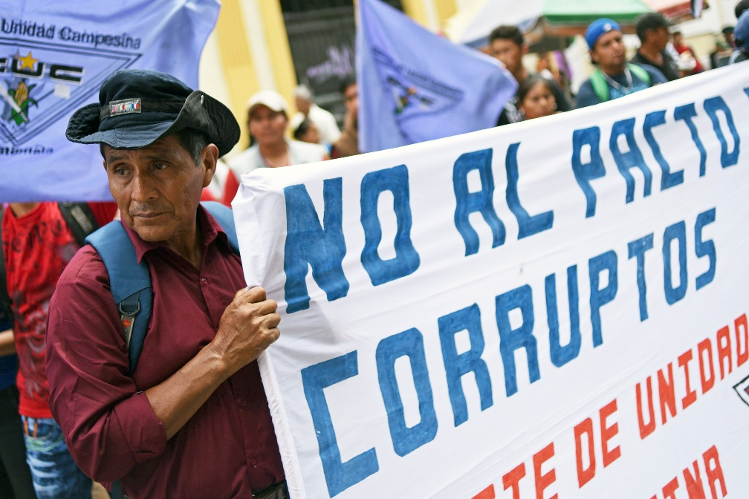
Guatemala
Malnutrition- Almost half of all children in Guatemala are malnourished
Water Pollution- 95% of produced water is unusable
Deforestation- Agriculture, logging, and forest fires are the leading causes of deforestation
Issues
Protestants outside of the government buildings protesting internal corruption
Corruption- Police and government are corrupt, making it easy for bribery and other illegal activities
Drug Trafficking- Main shipping route for drugs to South America
While children may not seem malnourished, their lack of food is exhibited through major growth stunts

Slide 18

Guatemala
Malnutrition- UN/international interference, provide meal replacements
Water Pollution- Stop polluting rivers by exporting or diverting waste
Deforestation- Sustainable foresting and crack down on illegal forestry
Solutions
Protestants outside of the government buildings protesting internal corruption
Corruption- Pass laws to limit the abilities of the corrupted, weed out the corrupt
Drug Trafficking- Crack down on the drug war
While children may not seem malnourished, their lack of food is exhibited by growth stunts

